Slide 1
Mozambique Applicants’ Conference RFA-MOZ-001
Kevin Vu, Engagement Manager
Godwin Protace, Interim Grants Manager
Daniella Maor, Senior Private Sector Engagement Advisor
November 8, 2022

Slide 2
We will begin momentarily

Slide 3
Agenda
Opening Remarks from
USAID/Mozambique ................................................ 5 Minutes
Overview of MSP Activity ........................................ 5 Minutes
Gender Lens Investing ............................................ 5 Minutes
Award Details & Timeline ...................................... 10 Minutes
Questions and Answers (Q&A) ............................ 35+ Minutes

Slide 4
Phelisha Midy Private Sector Economist and Deputy Ag Team Lead USAID/Mozambique

Slide 5
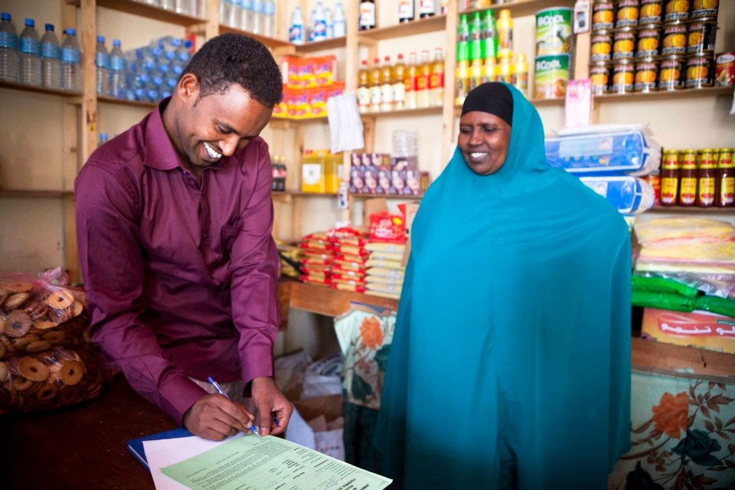
MARKET SYSTEMS AND PARTNERSHIPS ACTIVITY
Advancing learning and good practice on market systems development and private sector engagement.
www.agrilinks.org/msp

Slide 6
Why does USAID want to co-invest with the private sector?
USAID investment reduces risk to firms to invest, innovate, and engage in areas outside of normal business practices but within its core business interests.
Business solutions can have a positive development impact
Investing with the private sector results in more sustainable, market-oriented solutions

Slide 7
Gender Lens Investment
MSP is a gender-led investor that deliberately incorporates gender factors into investment analysis, solicitation, and partnership design to improve social and business outcomes. MSP always seeks opportunities to positively impact women and youth.
One of the objectives of this activity is to “Increase and improve linkages between market actors”, especially market actors who are women.
Within the application template for this award, you will see questions regarding your business concept’s impact on women, specifically “how it will benefit women as suppliers, as customers, or as employees.”
Be clear in your application to link your proposed concept with impact on women
Notes:
**All quotes directly from the publicly available RFA

Slide 8
Mozambique Partnership Facility Objectives
MSP’s Mozambique Partnerships Facility is national in scope and seeks to support businesses to contribute towards one or more of the following objectives:
Encouraging and incentivizing innovations and investments in agriculture food systems by agribusinesses linked with smallholder farmers and/or farmer associations/cooperatives.
Expanding fertilizer investment and finance across fertilizer supply chains.
Building systems capacity to manage future shocks and stressors.
Reducing food loss and waste.
Increasing investments in agriculture capacity and resilience (i.e., promoting increased agribusiness efficiency, last-mile distribution of local products, digital applications, etc.).

Slide 9
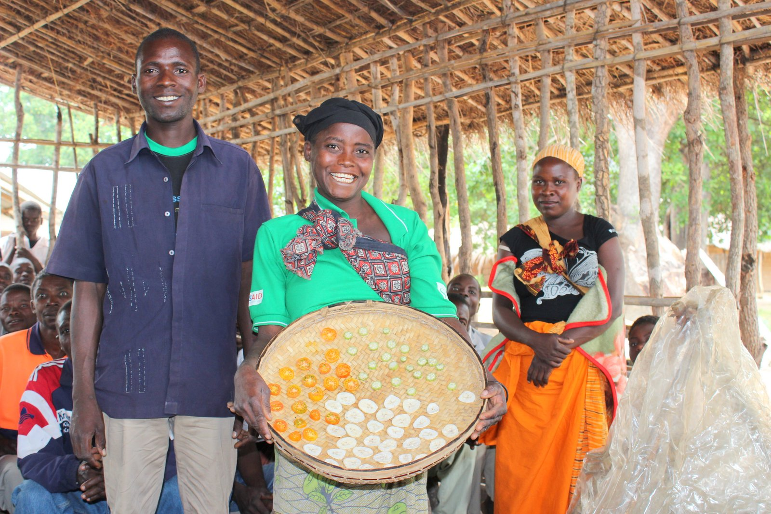
Illustrative Examples of Concepts
Warehousing, storage, cold chain, logistics/transportation, and other technologies that prolong shelf-life, improve food safety, and reduce product losses from damage or spoilage in agriculture market systems.
Agro-processing that generates additional income for smallholder farming households and expanded opportunities for groups (e.g., value addition, washing, grading, sorting, and packaging).
Practices that create circular economy opportunities where unsafe or inedible foods are safely recycled back into the food system for human, animal, or fish consumption.
Technologies that improve sanitary and phytosanitary food safety standards.
Climate-smart agriculture (CSA) technologies and practices.
Other practices or services that promote value addition and prevent food loss or waste, support fertilizer finance/supply chain, or agricultural resilience.
Innovations in agriculture food systems, including digital technologies and digital financing.
Notes:
Reminder, these examples are not a representation of the totality of examples. If any potential applicants have any concepts that fit within the project objectives listed in the previous slide, please feel free to submit an application. If there is any confusion or grey area, please feel free to query any questions during this conference or through the Mozambique RFA email.

Slide 10
Mozambique Partnership Facility Quick Facts
Investment Funding - $250,000-500,000
Required Co-Investment – 1:1 Investment (5:1 required if proposed activities include loans or equity investments)
Period of Performance – 2-years
Grant Type – Performance-based grants (fixed amount award)

Slide 11
Eligibility Information
Eligible applicants include:
Companies legally registered to operate in Mozambique at the time of award
Financial institutions, investors, businesses, business service providers, industry/sector organizations, trade, or other private sector associations in the agriculture food systems.
Ineligible applicants include:
NGOs, as the lead applicant;
Any entity listed in the U.S. government Excluded Parties List;
Any entity unable to obtain a Unique Entity Identifier (UEI);
Any Public International Organization (PIO);
Any entity affiliated with DAI or MSP directors, officers, or employees;
Any military organization, political party, labor union, or individual
Notes:
Note that the full list of these is included in Section III of the RFA

Slide 12
What is Co-Investment?
Cash investment from partner that takes place DURING the partnership (i.e. cannot be a past investment)
Examples of eligible costs: relevant staff time, materials, equipment, consulting services for studies or trainings.
Directly related to the partnership activities.

Slide 13
Mozambique Partnership Facility Timeline
RFA Release – October 25
Applicants Conference – November 8
Applications Due – December 30
Selected Apparent Successful Applicants – January 2023
Co-Development, Award Negotiation, Due Diligence, Cost Verification – January – May 2023
Awards Begin – June 2023

Slide 14
Q&A
Please share any questions regarding the process or the goals of the facility
Share any future questions with mozrfaquestions@ftf-msp.org and answers will be posted weekly to the MSP grants website.
The RFA and all application templates may be found at https://www.mspgrants.com/mozambique/

Slide 15
mozrfaquestions@ftf-msp.org www.agrilinks.org/msp

