Slide 1
Mozambique Applicants’ Conference RFA-MOZ-001
Mark Pigott, Engagement Manager
Ammar Shams Aldin, Grants Manager
Daniella Maor, Senior Private Sector Engagement Advisor
January 9, 2023
Notes:
Bronwyn to give welcome.

Slide 2
We will begin momentarily

Slide 3
Agenda
Opening Remarks................................................ 5 Minutes
Overview of MSP Activity ........................................ 5 Minutes
Gender Lens Investing ............................................ 5 Minutes
Award Details & Timeline ...................................... 10 Minutes
Questions and Answers (Q&A) ............................ 35+ Minutes
Notes:
Feel free to post in the chat if you have any questions during the presentation and they can be covered either during the presentation or addressed after in the Q&A.
Want to remind the room to please keep yourselves on mute throughout the presentation so that we can get through all of the covered material. At the end of the call, participants will have the opportunity to ask questions.
It would also be great to introduce yourself with your name, organization

Slide 4
USAID Intro
Pete Gauthier Private Enterprise Officer and Alliance Builder USAID/Mozambique

Slide 5
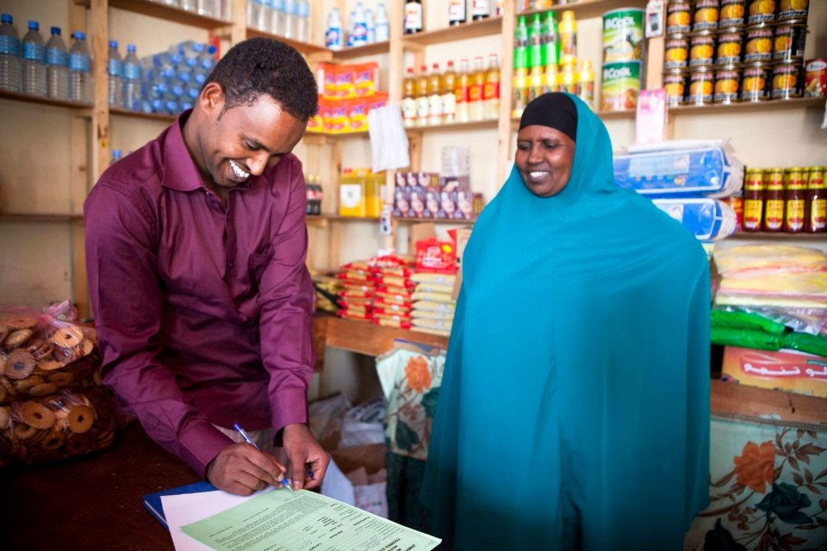
Market Systems and Partnerships Overview
Advancing learning and good practice on market systems development and private sector engagement
www.agrilinks.org/msp
Notes:
Bronwyn
DC-based project (buy-in mechanism) focused on learning and good practice on Market Systems Development (MSD) and Private Sector Engagement (PSE).
We operate globally implement in 10-20 countries, through our partnership programs, technical assistance, research projects.
Our partnerships (grants) are meant to fund innovative solutions that align with your business needs and our technical objectives

Slide 6
Why does USAID want to co-invest with the private sector?
USAID investment reduces risk to firms to invest, innovate, and engage in areas outside of normal business practices but within its core business interests.
Business solutions can have a positive development impact
Investing with the private sector results in more sustainable, market-oriented solutions
Notes:
Daniella
So why the private sector? USAID is a development agency which works to address development challenges around the world. MSP Moz is a project which sees the private sector as one of the main drivers for delivering development impact in a sustainable and market-oriented way. Ultimately, business challenges (trouble getting loans or investment, high cost of doing business, etc.) are development challenges which MSP Moz is well positioned to help to address. In this particular activity, MSP Moz is looking to work with private sector business partners to co-invest into a business concept in order to help to reduce the risk to businesses that it takes to test out new ideas or expand into new areas. Understanding the challenges, USAID would like to work with businesses directly to invest, innovate, and engage in areas outside of or expand its normal business practices.

Slide 7
Gender Lens investing
MSP is a gender-led investor that deliberately incorporates gender factors into investment analysis, solicitation, and partnership design to improve social and business outcomes. MSP always seeks opportunities to positively impact women and youth.
One of the objectives of this activity is to “Increase and improve linkages between market actors”, especially market actors who are women.
Within the application template for this award, you will see questions regarding your business concept’s impact on women, specifically “how it will benefit women as suppliers, as customers, or as employees.”
Be clear in your application to link your proposed concept with impact on women.
Notes:
**All quotes directly from the publicly available RFA

Slide 8
Mozambique Partnership Facility Objectives
MSP’s Mozambique Partnerships Facility is national in scope and seeks to support businesses to contribute towards one or more of the following objectives:
Encouraging and incentivizing innovations and investments in agriculture food systems by agribusinesses linked with smallholder farmers and/or farmer associations/cooperatives.
Expanding fertilizer investment and finance across fertilizer supply chains.
Building systems capacity to manage future shocks and stressors.
Reducing food loss and waste.
Increasing investments in agriculture capacity and resilience (i.e., promoting increased agribusiness efficiency, last-mile distribution of local products, digital applications, etc.).
Notes:
Mark: To initiate this process, MSP FLW has released a request for applications, which you all will have hopefully had access to through the MSP Access website. This document has a lot of details about what the overall objectives of the program are, who is eligible, and how to apply. We will just briefly run through some of the main components of the activity and then leave as much time as possible for you all to ask questions and share any feedback now that you have read and heard about this exciting opportunity.
The objectives are…

Slide 9
Illustrative Examples of Concepts
Warehousing, storage, cold chain, logistics/transportation, and other technologies that prolong shelf-life, improve food safety, and reduce product losses from damage or spoilage in agriculture market systems.
Agro-processing that generates additional income for smallholder farming households and expanded opportunities for groups (e.g., value addition, washing, grading, sorting, and packaging).
Practices that create circular economy opportunities where unsafe or inedible foods are safely recycled back into the food system for human, animal, or fish consumption.
Technologies that improve sanitary and phytosanitary food safety standards.
Climate-smart agriculture (CSA) technologies and practices.
Other practices or services that promote value addition and prevent food loss or waste, support fertilizer finance/supply chain, or agricultural resilience.
Innovations in agriculture food systems, including digital technologies and digital financing.
Notes:
Key focus areas are to reduce flw and shortages within Mozambique and helps to ensuring and prolonging the shelf life of food
Please note that in this point that there is a development impact focus on improving the livelihoods of small-holder farmers. Which is something that is something that you keep in mind and respond to when going through the application.
After going through all these concepts one common question that MSP receives is within eligibility requirements for warehousing and storage and agro- examples processing. We will go into more detail on eligibility requirements on a separate slide, but as long as warehousing and cold-chain storage projects do not require construction, these are completely eligible. However, if your project contains construction these are not eligible costs.
For agro-processing projects, any materials of labor that have been purchased or hired prior to the beginning of the project are ineligible costs. Again we will go into more details on this in another few slides.
Reminder, these examples are not a representation of the totality of examples. If any potential applicants have any concepts that fit within the project objectives listed in the previous slide, please feel free to submit an application. If there is any confusion or grey area, please feel free to query any questions during this conference or through the Mozambique RFA email.

Slide 10
Mozambique Partnership Facility Quick Facts
Investment Funding - $250,000-500,000
Required Co-Investment – 1:1 Investment (5:1 required if proposed activities include loans or equity investments)
Period of Performance – 2-years
Grant Type – Performance-based grants (fixed amount award)
Notes:
Funding range: $250,000 to $500,000 per award – This is funding available from MSP
Co-investment: 1:1 – means that for every dollar you request from MSP, you much also put in a dollar of company funding
On the next slide we’ll talk more about what qualifies for co-investment
2-year partnerships – from the time of signing a final award
Pay-for-performance – fixed amount awards
This means we set all activities and costs upfront and that each award will have a set of negotiated milestones designed to measure partnership progress and success
For example, if the objective of our partnership is to increase farmer access to cold chain services, there would be milestones corresponding to the number of farmers who gain access to those services (via purchase records, etc) and the different types of services.
There may also be a milestone for a farmer outreach plan or last-mile distribution plan
All milestones will be designed and negotiated during our co-development process, which we’ll talk more about in a minute
The fixed amount award model also means that all costs will be negotiated up front.
Because award payments are made based on milestone achievement, during implementation we do not pay for actual cost incurred.
Instead we ask to develop and verify the budget up front. This means verifying cost via quotes from vendors or market research.
During the negotiation process, MSP will help guide partners through this process

Slide 11
Eligibility Information
Eligible applicants include:
Companies that are legally registered to operate in Bangladesh, Kenya, Nepal, Niger, Nigeria, and/or Tanzania at the time of award
Financial institutions, investors, businesses, business service organizations, industry/sector organizations, trade or other private sector associations
Ineligible applicants include:
NGOs
Any entity listed in the U.S. government Excluded Parties List.
Any entity unable to obtain a Unique Entity Identifier (UEI)
Any Public International Organization (PIO).
Any entity affiliated with DAI or MSP directors, officers, or employees.
Any military organization, political party, labor union, or individual
Notes:
Note that the full list of these is included in Section III of the RFA
Note that the full list of these is included in Section III of the RFA
Time of Award: If you are currently not operating within Mozambique, but are planning to in the next 6-7 months your company can still apply
UEI: If you are familiar with past US government-funded projects, the UEI has replaced the DUNS in Sam Search. If you do not have a UEI number, will ask you to apply for one. We know that this can be a drawn-out process, so there are some caveats to this. If you can display that you are in process of getting the UEI, your firm will be eligible. MSP will help you through the co-development process to obtain one.

Slide 12
What is Co-Investment?
Cash investment from partner that takes place DURING the partnership (i.e. cannot be a past investment)
Examples of eligible costs: relevant staff time, materials, equipment, consulting services for studies or trainings.
Directly related to the partnership activities.
Notes:
Cash investment during the partnership
We cannot include costs already incurred. For example, if you have already purchased a piece of equipment it can not be included even if it is not in use yet.
All costs must be incurred after the signing of the partnership
Eligible costs—Refer to list of ineligible costs in Attachment 2 of the RFA and highlight the big ones:
Construction, fertilizers, pesticides, seeds (only on partner contribution side), profit or fee,
All costs must be directly related to partnership activities and the completion of milestones
We do not count costs that would be considered “biz as usual”
For example, existing office space, accountants, bank fees – these are all cost needed to run your business and not directly related to the MSP partnership
We also would not include reoccurring costs associated with creating your product.
Example: if the objective of the award is to introduce new technologies for processing mango and source from smallholder farmers – we would not consider the cost of purchasing raw mangos from farmers, but we would include costs for equipment and materials needed for the new processing line.

Slide 13
Mozambique Partnership Facility Timeline
RFA Release – October 25
Applicants Conference – November 8
Applicants Conference #2 – January 9
Applications Due – January 2023
Selected Apparent Successful Applicants – February 2023
Co-Development, Award Negotiation, Due Diligence, Cost Verification – February – July 2023
Awards Begin – July/August 2023
Notes:
Mozambique Partnership Facility Timeline
The RFA is already live and we are currently going through the Applicant Conference. The Solicitation Process is currently ongoing and applications are due on January 27. If there are any questions from a tech or compliance standpoint after this conference, please feel free to email the Mozambique RFA email, that is provide on the msp grants page and these questions will be answered every Tuesday up to January 20 by the MSP team.
Review: all eligible applications are reviewed by a technical evaluation committee that will evaluate proposals based on the criteria outlined on page 4 of the RFA document
From that review all applicants will be notified of their status and shortlisted applicants will enter into the co-development and award negotiation phase at the beginning in February 2023
This is the time when partnership activities will be refined, and milestones will be developed.
This is also when due diligence is conducted to assess organizational and financial capacity of the firm
This is when the budget negotiation and cost verification process take place. Every line item of the budget will need to be verified and transactions over $5,000 require 3 quotes.
Keep that in mind as you design your budgets
MSP staff will help guide you through the process
The co-development and negotiation phase is time intensive because it sets up everything we need for implementation and reduces the administrative burden during the implementation phased – because everything has been negotiated up front
Because of this is can often take 4 – 5 months taking place between February-July 2023
After the co-development process take place awards begin and the implementation phase projects to start in July/August 2023

Slide 14
Q&A
Please share any questions regarding the process or the goals of the facility
Share any future questions with mozrfaquestions@ftf-msp.org and answers will be posted weekly to the MSP grants website.
The RFA and all application templates may be found at https://www.mspgrants.com/mozambique

