Slide 1
Food Loss and Waste (FLW)
Partnership Facility Round 2
Applicants’ Conference
RFA-FLW-002
Mark Pigott, Engagement Manager
Nate Odendahl, Associate Engagement Manager
Daniella Maor, Senior Private Sector Engagement Advisor
Nate Hulley, Chief of Party
July 20, 2023
We will begin momentarily
Notes:
Daniella to give welcome.

Slide 2
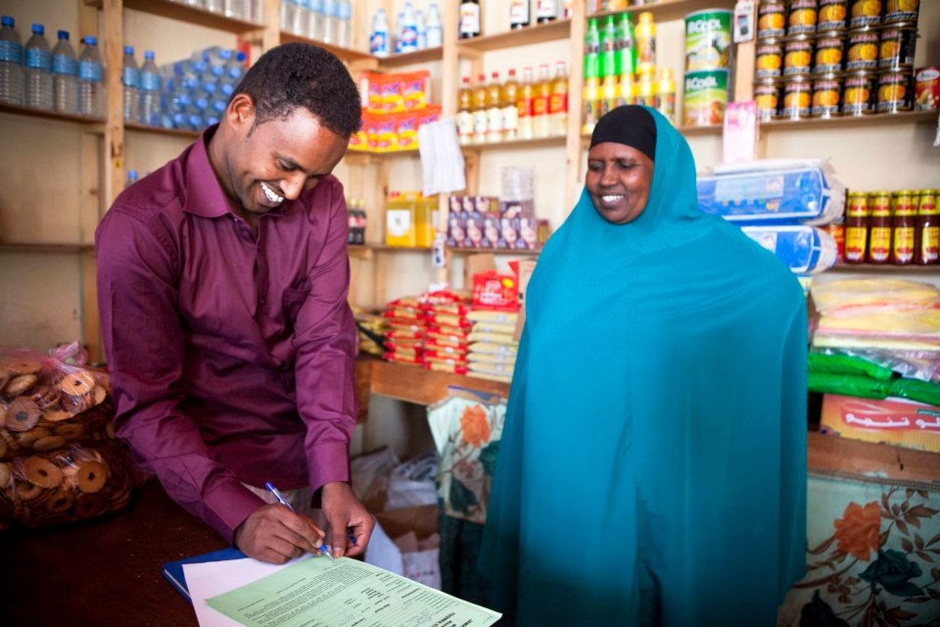
Market Systems and Partnerships Overview
Advancing learning and good practice on market systems development and private sector engagement
www.agrilinks.org/msp
Notes:
Daniella
DC-based project (buy-in mechanism) focused on learning and good practice on Market Systems Development (MSD) and Private Sector Engagement (PSE).
We operate globally implement in 10-20 countries, through our partnership programs, technical assistance, research projects.
Our partnerships (grants) are meant to fund innovative solutions that align with your business needs and our technical objectives

Slide 3
Why does USAID want to co-invest with the private sector?
USAID investment reduces risk to firms to invest, innovate, and engage in areas outside of normal business practices but within its core business interests.
Business solutions can have a positive development impact
Investing with the private sector results in more sustainable, market-oriented solutions
Notes:
Daniella
So why the private sector? USAID is a development agency which works to address development challenges around the world. MSP FLW is a project which sees the private sector as one of the main drivers for delivering development impact in a sustainable and market-oriented way. Ultimately, business challenges (trouble getting loans or investment, high cost of doing business, etc.) are development challenges which MSP FLW is well positioned to help to address. In this particular activity, MSP FLW is looking to work with private sector business partners to co-invest into a business concept in order to help to reduce the risk to businesses that it takes to test out new ideas or expand into new areas. Understanding the challenges, USAID would like to work with businesses directly to invest, innovate, and engage in areas outside of or expand its normal business practices.

Slide 4
Gender Lens investing
MSP is a gender-led investor that deliberately incorporates gender factors into investment analysis, solicitation, and partnership design to improve social and business outcomes. MSP always seeks opportunities to positively impact women and youth.
One of the objectives of all MSP partnerships is to increase and improve linkages between market actors, especially market actors who are women.
Within the application template for this award, you will see questions regarding your business concept’s impact on women, specifically “how it will benefit women as suppliers, as customers, or as employees.”
Be clear in your application to link your proposed concept with impact on women.
Notes:
**All quotes directly from the publicly available RFA
Two main points – the reason why MSP is focused on Gender Led investment is because there is proven benefit.
Work with partners to meet them where they are at. Innovative within the context.

Slide 5
FLW Partnership Facility Round 2 Objectives
MSP’s FLW Partnerships Facility Round 2 seeks to support businesses to contribute towards one or more of the following objectives:
Pilot innovative solutions to reduce food loss and waste with an emphasis on nutrient dense products throughout the supply chain in target countries.
Reduce methane and other greenhouse gas (GHG) emissions through reduction in food loss and waste via improved practices in storage and distribution, and processing.
Create circular economy systems of regeneration within focus countries’ food systems so that waste does not exist but is instead used as feedstock for another cycle.
Strengthen the focus countries’ agricultural competitiveness through enhanced services, private sector engagement, and investment, especially within nutrient dense value chains.
Improve the focus countries’ resilience and capacity to mitigate and respond to food system shocks.
Notes:
Nate: To initiate this process, MSP FLW has released a request for applications, which you all will have hopefully had access to through the MSP Access website. This document has a lot of details about what the overall objectives of the program are, who is eligible, and how to apply. We will just briefly run through some of the main components of the activity and then leave as much time as possible for you all to ask questions and share any feedback now that you have read and heard about this exciting opportunity.
The objectives are…

Slide 6
Illustrative Examples of Concepts
Warehousing, storage, cold chain, transportation, and other technologies that prolong shelf-life, improve food safety, and reduce product losses from damage or spoilage.
Agro-processing that reduces microbial contamination, improves food safety, and generates additional income for smallholder farming households and expanded opportunities for farmer groups (e.g., value addition, washing, grading, and packaging).
Technologies that improve sanitary and phytosanitary food safety standards.
Innovations to prevent postharvest food loss (e.g. crates to carry produce, cooling facilities, spraying of biodegradable biofilm, etc.) focused on nutrient dense agricultural products.
Climate smart practices that create circular economy opportunities where unsafe or inedible foods are safely recycled back into the food system for human, livestock, poultry, fish or other animal consumption, especially those focused on nutrient dense products and value chains (e.g. Black soldiers fly or other insects for food or feed, compositing, anaerobic digestion).
Other innovations that promote value addition, nutrient dense agricultural products, and prevent food loss or waste.
Processes that extend the shelf-life of perishable and nutrient dense agriculture products.
Notes:
This is not an exhaustive list, if you can make a clear proposed concept in a reduction of food loss waste.

Slide 7
FLW Partnership Facility Quick Facts
Investment Funding - $250,000-$2,000,000
Required Co-Investment – 1:1 Investment (5:1 required if proposed activities include loans or equity investments)
Period of Performance – 2-years
Grant Type – Performance-based grants (fixed amount award). Grant payments are made upon accomplishment of preestablished milestones. Milestones are developed between MSP and the partner prior to the grant being awarded.
Notes:
Funding range: $250,000 to 2,00,000 per award – This is funding available from MSP
Co-investment: 1:1 – means that for every dollar you request from MSP, you much also put in a dollar of company funding
On the next slide we’ll talk more about what qualifies for co-investment
2-year partnerships – from the time of signing a final award
Pay-for-performance – fixed amount awards
This means we set all activities and costs upfront and that each award will have a set of negotiated milestones designed to measure partnership progress and success
For example, if the objective of our partnership is to increase farmer access to cold chain services, there would be milestones corresponding to the number of farmers who gain access to those services (via purchase records, etc) and the different types of services.
There may also be a milestone for a farmer outreach plan or last-mile distribution plan
All milestones will be designed and negotiated during our co-development process, which we’ll talk more about in a minute
The fixed amount award model also means that all costs will be negotiated up front.
Because award payments are made based on milestone achievement, during implementation we do not pay for actual cost incurred.
Instead we ask to develop and verify the budget up front. This means verifying cost via quotes from vendors or market research.
During the negotiation process, MSP will help guide partners through this process

Slide 8
What is Co-Investment?
Cash investment from partner that takes place DURING the partnership (i.e. cannot be a past investment)
Examples of eligible costs: relevant staff time, materials, equipment, consulting services for studies or trainings.
A full list of ineligible co-investment costs is in Attachment 2 (page 21) of the RFA.
Directly related to the partnership activities.
Notes:
Cash investment during the partnership
We cannot include costs already incurred. For example, if you have already purchased a piece of equipment it can not be included even if it is not in use yet.
Commit do co-investing out of own funding over the course of the project.
All costs must be incurred after the signing of the partnership
Eligible costs—Refer to list of ineligible costs in Attachment 2 of the RFA and highlight the big ones:
Construction, fertilizers, pesticides, seeds (only on partner contribution side), profit or fee,
All costs must be directly related to partnership activities and the completion of milestones
We do not count costs that would be considered “biz as usual”
For example, existing office space, accountants, bank fees – these are all cost needed to run your business and not directly related to the MSP partnership
We also would not include reoccurring costs associated with creating your product.
Example: if the objective of the award is to introduce new technologies for processing mango and source from smallholder farmers – we would not consider the cost of purchasing raw mangos from farmers, but we would include costs for equipment and materials needed for the new processing line.

Slide 9
Eligibility Information
Eligible applicants include:
Companies that are legally registered to operate in Bangladesh, Kenya, Nepal, Niger, Nigeria, and/or Tanzania at the time of award
Financial institutions, investors, businesses, business service organizations, industry/sector organizations, trade or other private sector associations
Ineligible applicants include:
NGOs
Any entity listed in the U.S. government Excluded Parties List
Any entity unable to obtain a Unique Entity Identifier (UEI)
Any Public International Organization (PIO)
Any entity affiliated with DAI or MSP directors, officers, or employees
Any military organization, political party, labor union, or individual
Notes:
Note that the full list of these is included in Section III of the RFA

Slide 10
Evaluation Criteria
The Review Committee will score and evaluate applications based on the strength of the six elements addressed in Section II, Description of the Technical Approach. All six elements of the Technical Approach are weighted equally.
Technical Approach Elements
Proposed Business Concept
B. Development Impact
C. Climate Impact
D. Sustainability
E. Scale
F. Funding Justification
Scoring Description (Section V of RFA)
5 – Outstanding: Exceeds expectations with comprehensive and outstanding merit.
4 – Good: Meets or exceeds requirements and demonstrates and understanding of the objectives and its alignment with the criteria.
3 – Satisfactory: Meets minimum requirements and is mostly aligned with the criteria.
2 – Marginal: Minimally meets basic requirements but demonstrates a limited understanding of the partnership requirements.
1 – Poor: Does not meet basic requirements and fails to address the criteria completely.
Notes:
The Review Committee will score and evaluate applications based on the strength of the six elements addressed in Section II, Description of the Technical Approach. Please refer to Section II for the full description of the Technical Approach elements.

Slide 11
Tips for Preparing Your Application
Applications MUST:
Use the technical and budget templates provided by MSP and in the format requested.
Technical applications must be 9 pages or fewer and respond to all questions.
Fall within the funding range and meet at least 1:1 co-investment.
Be submitted on time and through the MSP grants portal
Applications must be in English or French
Applications SHOULD:
Provide clear responses in all sections of the concept. All sections are considered equally in evaluation.
Demonstrate feasibility within a 2-year period of performance.
Communicate why the approach is innovative and why MSP funding is needed.

Slide 12
FLW Partnership Facility Round 2 Timeline
Activity | Dates
RFA Issued Applications Due Application Review Finalists Notified and Recommended for Awards Co-Development and Award Negotiation Period Start Date for Awarded Grants | June 21, 2023 August 18, 2023 August 2023 – September 2023 October 2023 October 2023 – March 2024 April 2024
Notes:
Review: all eligible applications are reviewed by a technical evaluation committee that will evaluate proposals based on the criteria outlined on page 10 of the RFA document
From that review all applicants will be notified of their status.
There are three status options: shortlisted to enter co-development, and waitlisted to enter co-development depending on availability of more funds, and not selected.
Shortlisted applicants will enter into the co-development and award negotiation phase
This is the time when partnership activities will be refined, and milestones will be developed.
This is also when due diligence is conducted to assess organizational and financial capacity of the firm
This is when the budget negotiation and cost verification process take place. Every line item of the budget will need to be verified via quotes and costs over $5,000 require 3 quotes.
Keep that in mind as you design your budgets
MSP staff will help guide you through the process
The co-development and negotiation phase is time intensive because it sets up everything we need for implementation and reduces the administrative burden during the implementation phased – because everything has been negotiated up front
Because of this is can often take 5-6 months

Slide 13
Q&A
Please share any questions regarding the process or the goals of the facility
Share any future questions with flwgrants_nofo@ftf-msp.org and answers will be posted weekly to the MSP grants website.
The RFA and all application templates may be found at https://www.mspgrants.com/flw2

