Slide 1
Feed the Future Market Systems and Partnerships (MSP) Activity
Cambodia Agricultural Investment Activity
March 17, 2021

Slide 2
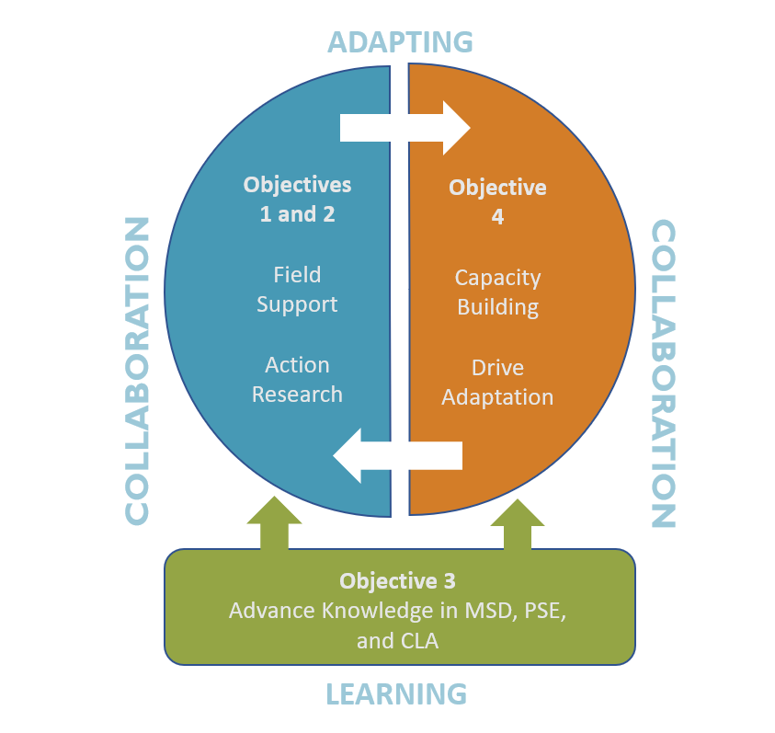
Market Systems and Partnerships
A global USAID buy in activity based in Washington, DC
$64.9m contract with $30m grants fund
Driving cultural change and operational learning in the integration of private sector engagement across all activities and deepening of market systems development across the FTF program cycle.
Notes:
To insert your implementing partner institutional logo, go to View >> Slide Master, and replace the gray box with your logo, placing it to the right of the USAID logo at the bottom. No text or partner logos can be placed within the upper blue banner.

Slide 3
Cambodia Agricultural Investment Activity
USAID/Cambodia is offering opportunities for co-investment with private sector actors in Cambodia to improve:
Cold chain
Temperature-controlled supply chain
Agricultural storage capacity
Warehouses, deposits, or holdings of farm products
Logistics
Connectivity between production and consumption centers, over space and time, with minimal loss in quality and quantity
Notes:
To insert your implementing partner institutional logo, go to View >> Slide Master, and replace the gray box with your logo, placing it to the right of the USAID logo at the bottom. No text or partner logos can be placed within the upper blue banner.

Slide 4
Application process
Co-investment Parameters
Funding amount & type – Performance based grants between $100,000-$1,000,000
Performance period – 24 months
Stage 1 - Concept Paper Submission
Stage 2 - Co-development, Due Diligence, & Grant Application
Notes:
To insert your implementing partner institutional logo, go to View >> Slide Master, and replace the gray box with your logo, placing it to the right of the USAID logo at the bottom. No text or partner logos can be placed within the upper blue banner.

Slide 5
Eligibility Requirements
Proposed activities must take place in Cambodia and applicants must be registered before the anticipated start of the grant in Fall 2021
Concept must have 1:1 matching cash contribution
Activities must be related to private sector solutions addressing cold storage, logistics, or storage in the agriculture sector
NEW - Any cost related to construction—including building renovations—cannot be funded under this APS, whether through the grant or as part of the one-to-one cash contribution
Selection Criteria
The idea
The value of the partnership
The future of the business
The business and community impact
Notes:
To insert your implementing partner institutional logo, go to View >> Slide Master, and replace the gray box with your logo, placing it to the right of the USAID logo at the bottom. No text or partner logos can be placed within the upper blue banner.

Slide 6
Timeline
Issuance Date: February 24, 2021
Deadline for Questions: 8:00 ICT, April 9, 2021
Answers published: Every Tuesday until April 12, 2021
Closing Date Concept Papers: 8:00 PM ICT April 16, 2021
Co-Development Period: May-July
Closing Date Full Applications: 8:00 PM ICT August 31, 2021
Finalists Recommended for Award: No later than September 15, 2021
Estimated Start Date of Grants: November 2021
APS Closing Date: 8:00 PM ICT August 31, 2021

Slide 7
How to Apply
Submit Questions to: grants_nofo@ftf-msp.org
Submit Concept Papers to: Concept Papers (Stage 1) must be uploaded to www.mspgrants.com/cambodia
Submit Full Applications to: Full applications (stage 2) must be uploaded to www.mspgrants.com/cambodia

Slide 8
Thank you!
For any further questions or inquiries, please contact:
grants_nofo@ftf-msp.org

